Slide 1


Task Oriented Programming
with
-
A Domain Specific Language embedded in
Rinus Plasmeijer – Bas Lijnse
Peter Achten – Pieter Koopman - Steffen Michels
Jurriën Stutterheim - Markus Klinik - Tim Steenvoorden - Mart Lubbers – Arjan Oortgiesen
Jan Martin Jansen (NLDA) – John van Groningen - Laszlo Domoszlai (ELTE)
Radboud University Nijmegen

Slide 2
Tasks, Tasks Combinators, Data Exchange
Tasks
Basic Tasks
Non-interactive
return, throw, …
Interactive editors
interact , and derived combinators like enterInformation , showInformation , …
Combinators
Sequential
step, and derived combinators like >>* , >>= , >>|,…
Parallel
parallel, and derived combinators like -&&-, -||- , …
Data exchange between tasks
Locally Observable Task Values: :: Task a
Globally Observable Shared Data Sources : :: RWShared r w

Slide 3



Sequential Combinator : Step >>*
(Task a) >>* [TaskCont a b] → Task b
Observe Task a, continue with one of the Task b's: - if a certain action is performed by the end-user (normal priority) - if the value of the observed task is satisfying a certain predicate (high priority) - or the observed task has raised an exception to be handled here (highest priority)
>>*

Slide 4
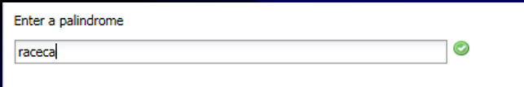
Sequential Combinator: >>*
palindrome :: Task String
palindrome = enterInformation "Enter a palindrome" []

Slide 5


Sequential Combinator: >>*
palindrome :: Task (Maybe String)
palindrome = enterInformation "Enter a palindrome" []
>>* [ OnAction ActionOk (ifValue isPalindrome (\v → return (Just v)))
, OnAction ActionCancel (always (return Nothing))
]

Slide 6
Sequential Step Combinator
Combinator for Sequential Composition
(>>*) infixl 1 :: (Task a) [TaskCont a b] → Task b | iTask a & iTask b
:: TaskCont a b
= OnAction Action ((TaskValue a) → Maybe (Task b))
| OnValue ((TaskValue a) → Maybe (Task b))
| E.e: OnException (e → Task b) & iTask e
:: Action = Action String
ActionOk :== Action "Ok"

Slide 7
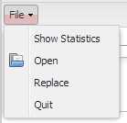
Sequential Step Combinator
Combinator for Sequential Composition
(>>*) infixl 1 :: (Task a) [TaskCont a b] → Task b | iTask a & iTask b
:: TaskCont a b
= OnAction Action ((TaskValue a) → Maybe (Task b))
| OnValue ((TaskValue a) → Maybe (Task b))
| E.e: OnException (e → Task b) & iTask e
:: Action = Action String
ActionOpen :== Action "/File/Open"

Slide 8
Sequential Step Combinator
Combinator for Sequential Composition
(>>*) infixl 1 :: (Task a) [TaskCont a b] → Task b | iTask a & iTask b
:: TaskCont a b
= OnAction Action ((TaskValue a) → Maybe (Task b))
| OnValue ((TaskValue a) → Maybe (Task b))
| E.e: OnException (e → Task b) & iTask e
always :: (Task b) (TaskValue a) → Maybe (Task b)
always taskb _ = Just taskb
ifValue :: (a → Bool) (a → Task b) (TaskValue a) → Maybe (Task b)
ifValue pred ataskb (Value a _) = if (pred a) (Just (ataskb a)) Nothing
ifValue _ _ _ = Nothing
hasValue :: (a → Task b) (TaskValue a) → Maybe (Task b)
hasValue ataskb (Value a _) = Just (ataskb a)
hasValue _ _ = Nothing
ifStable :: (a → Task b) (TaskValue a) → Maybe (Task b)
ifStable ataskb (Value a True) = Just (ataskb a)
ifStable _ _ = Nothing
8
Notes:
8

Slide 9
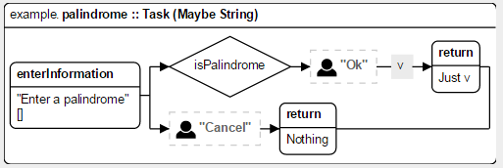

Sequential Combinator: >>*
palindrome :: Task (Maybe String)
palindrome = enterInformation "Enter a palindrome" []
>>* [ OnAction ActionOk (ifValue isPalindrome (\v → return (Just v)))
, OnAction ActionCancel (always (return Nothing))
]

Slide 10
Derived Sequential Combinators: Monadic-style
Monadic style:
(>>=) infix 1 :: (Task a) (a → Task b) → Task b | iTask a & iTask b
return :: a → Task a | iTask a
(>>|) infix 1 :: (Task a) (Task b) → Task b | iTask a & iTask b
(>>=) infix 1 :: (Task a) (a → Task b) → Task b | iTask a & iTask b
(>>=) taska ataskb
= taska
>>* [OnAction ActionContinue (hasValue ataskb)
, OnValue (ifStable ataskb)
]
10
Notes:
10

Slide 11
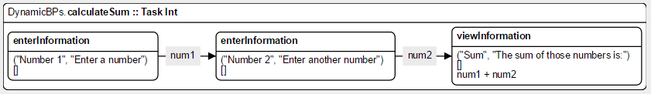

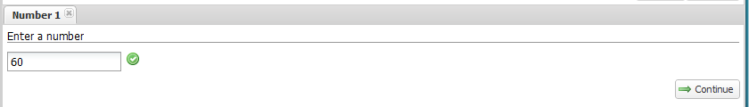
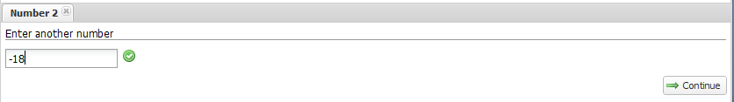
Simple Sum
calculateSum :: Task Int
calculateSum
= enterInformation ("Number 1","Enter a number") []
>>= \num1 → enterInformation ("Number 2","Enter another number") []
>>= \num2 → viewInformation ("Sum","The sum of those numbers is:") [] (num1 + num2)
11
Notes:
11

Slide 12
Derived Combinators of the Parallel Combinator
Any thinkable parallel way of working can be expressed with one-and-the-same Parallel Core – Combinator !
Here are some handy derived instantiations:
and : return values of all (embedded) parallel tasks:
(-&&-) infixr 4 :: (Task a) (Task b) → Task (a, b) | iTask a & iTask b
allTasks :: [Task a] → Task [a] | iTask a
or: return result of (embedded) parallel tasks yielding a value as first:
(-||-) infixr 3 :: (Task a) (Task a) → Task a | iTask a
eitherTask :: (Task a) (Task b) → Task (Either a b) | iTask a & iTask b
anyTask :: [Task a] → Task a | iTask a
one-of: start two tasks, but we are only interested in the result of one of them, use the other to inform:
(-||) infixl 3 :: (Task a) (Task b) → Task a | iTask a & iTask b
(||-) infixr 3 :: (Task a) (Task b) → Task b | iTask a & iTask b

Slide 13

One User may have many parallel tasks to work on..
-||-
-&&-
Internet
There can be many components !!!
Lay-outing needed to order all GUI’s
Default lay-out algorithme + lay-out directives
13
Notes:
13
Opbouwen op basis van de componenten uit ingredienten sheet.

Slide 14
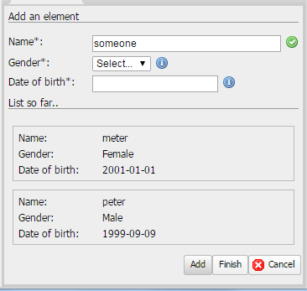
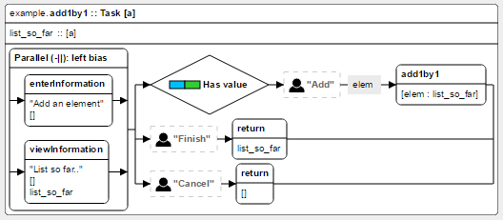
Recursive Tasks
add1by1 :: [a] → Task [a] | iTask a
add1by1 list_so_far
= enterInformation "Add an element" []
-||
viewInformation "List so far.." [] list_so_far
>>* [ OnAction (Action "Add") (hasValue (\elem → add1by1 [elem : list_so_far])
, OnAction (Action "Finish") (always (return list_so_far))
, OnAction ActionCancel (always (return []))
]
person1by1 :: Task [Person]
person1by1 = add1by1 []

Slide 15
Derived Combinators of the Parallel Combinator
Any thinkable parallel way of working can be expressed with one-and-the-same Parallel Core – Combinator !
Here are some handy derived instantiations:
and : return values of all (embedded) parallel tasks:
(-&&-) infixr 4 :: (Task a) (Task b) → Task (a, b) | iTask a & iTask b
allTasks :: [Task a] → Task [a] | iTask a
or: return result of (embedded) parallel tasks yielding a value as first:
(-||-) infixr 3 :: (Task a) (Task a) → Task a | iTask a
eitherTask :: (Task a) (Task b) → Task (Either a b) | iTask a & iTask b
anyTask :: [Task a] → Task a | iTask a
one-of: start two tasks, but we are only interested in the result of one of them, use the other to inform:
(-||) infixl 3 :: (Task a) (Task b) → Task a | iTask a & iTask b
(||-) infixr 3 :: (Task a) (Task b) → Task b | iTask a & iTask b
assign a task to a specific user:
(@:) infix 3 :: User (Task a) → Task a | iTask a

Slide 16



Assigning Tasks to Users
-&&-
@:
@:
Internet
16
Notes:
16
Opbouwen op basis van de componenten uit ingredienten sheet.

Slide 17
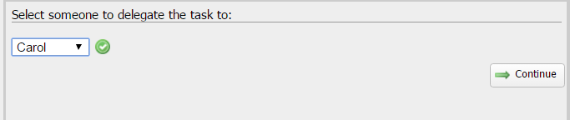
Multi-users
delegate :: (Task a) → Task a | iTask a
delegate task
= enterChoiceWithShared "Select someone to delegate the task to:" [] users
>>= \user → user @: (task >>= return)
>>= \result → > viewInformation "The result is:" [] result

Slide 18




Shared Data Sources
There are many different types of data storages, sources, sinks, one can use to exchange information:
- Shared Memory , Files , Cloud , Time , Sensors , ….
SDS: one abstraction layer for any type of shared data: easy to use for the progammer
:: RWShared r w
- Reading and Writing can be of different type
- It includes a publish-subscribe system:
* task looking at a share are automatically notified when the share has changed
- Fine-tuning : * which kind of change should trigger a notification ? * how to react on a race-condition ?
- SDS’s can be composed from others using special Share Combinators
:: Shared a :== RWShared a a
:: ReadOnlyShared a :== RWShared a Void
:: WriteOnlyShared a :== RWShared Void a

Slide 19
Shared Data Sources
Creating an SDS:
withShared :: a ((Shared a) → Task b) → Task b | iTask b // Shared memory
sharedStore :: String a → Shared a | iTask a // Special File
externalFile :: FilePath → Shared String // Ordinary File
sqlShare :: SQLDatabase String … → ReadWriteShared r w // SQL Database
Reading an SDS:
get :: (RWShared r w) → Task r | iTask r // read once
currentTime :: ReadOnlyShared Time
currentDate :: ReadOnlyShared Date
currentDateTime :: ReadOnlyShared DateTime
currentUser :: ReadOnlyShared User
users :: ReadOnlyShared [User]
Updating an SDS:
set :: w (RWShared r w) → Task w | iTask w // write once
update :: (r → w) (RWShared r w) → Task w | iTask r & iTask w

Slide 20
Interactive Editors on SDS’s
viewSharedInformation :: p [ViewOption r] (RWShared r w) → Task r
| toPrompt p & iTask r
updateSharedInformation :: p [UpdateOption r w] (RWShared r w) → Task w
| toPrompt p & iTask r & iTask w
enterSharedChoice :: p [ChoiceOption a] (RWShared [a] w) → Task a
| toPrompt p & iTask a & iTask w
updateSharedChoice :: p [ChoiceOption a] (RWShared [a] w) a → Task a
| toPrompt p & iTask a & iTask w
enterSharedMultipleChoice :: p [MultiChoiceOption a] (RWShared [a] w) → Task [a]
| toPrompt p & iTask a & iTask w
updateSharedMultipleChoice :: p [MultiChoiceOption a] (RWShared [a] w) [a] → Task [a] | toPrompt p & iTask a & iTask w

Slide 21

Editors on SDS’s
viewCurDateTime :: Task DateTime
viewCurDateTime
= viewSharedInformation "The current date and time is:" [] currentDateTime
Ticking !!

Slide 22
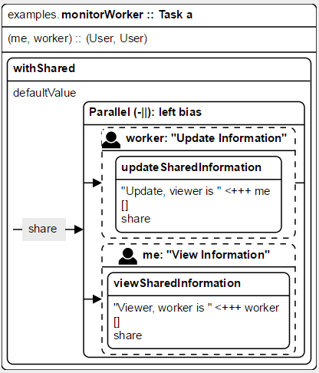
Editors on SDS’s
22
monitorWorker :: ((User, String), (User, String)) → Task a | iTask a
monitorWorker ((me,my_prompt), (you,your_prompt))
= withShared defaultValue
(\share → (you @: updateSharedInformation (your_prompt, "viewer is " <+++ me) [] share)
-||
(me @: viewSharedInformation (my_prompt, "worker is " <+++ worker) [] share)
)
Notes:
22

Slide 23

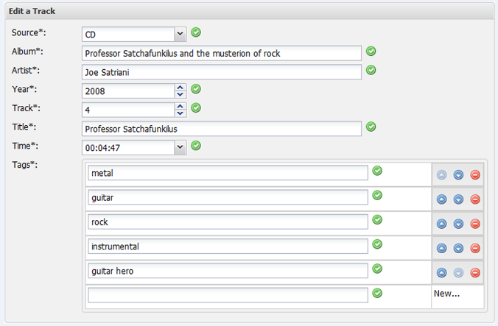
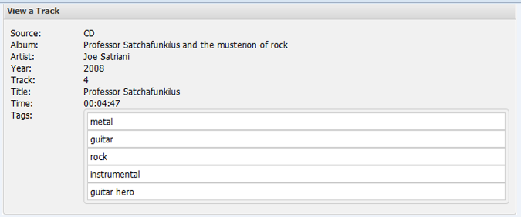
Editors on SDS’s
addTrack :: Task Track
addTrack = monitorWorker (("peter",“View a Track"),(“rinus",“Edit a Track"))

Slide 24
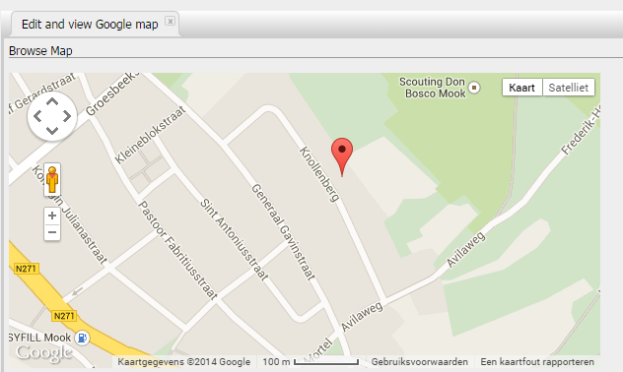
Editors on SDS’s
24
changeMap :: Task GoogleMap
changeMap = monitorWorker (("peter", "View Map"),("rinus", "Browse Map"))
Notes:
24

Slide 25
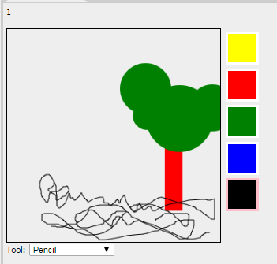
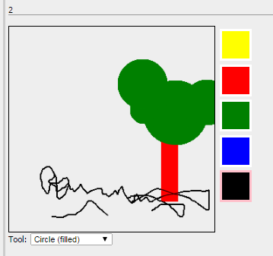
Editors on SDS’s
25
changeMap :: Task Drawing
changeMap = monitorWorker ((“bert", "View Drawing"),(“ernie", “Make Drawing"))
Notes:
25

Slide 26
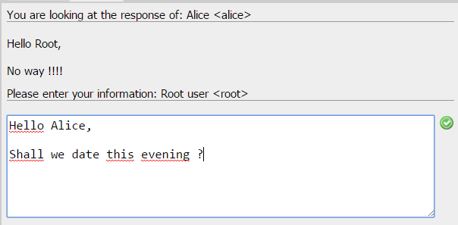
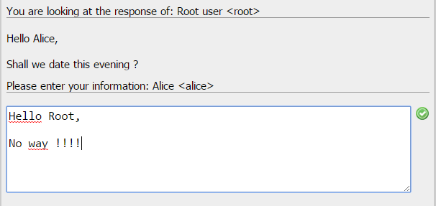
Chatting Using SDS’s
26
chat :: Task (a,b) | iTask a & iTask b
chat
= selectCoWorker "with whom do you want to work ? "
>>= \(me,colleague) → withShared defaultValue
(\workOfMe → withShared defaultValue
(\workOfColleague -> ((me,"chat") @: updateAndView (me,workOfMe) (colleague,workOfColleague))
&&-
((colleague,"chat") @: updateAndView (colleague,workOfColleague) (me,workOfMe))
))
selectCoWorker :: String → Task (User, User)
selectCoWorker prompt
= get currentUser
>>= \me -> enterChoiceWithShared prompt [] users
>>= \colleague -> return (me,colleague)
updateAndView :: (User, Shared a) (User, Shared b) → Task a | iTask a & iTask b
updateAndView (me, workOfMe) (you, workOfYou)
= updateSharedInformation ("Please enter your information: " <+++ me) [] workOfMe
-||
viewSharedInformation ("You are looking at the response of: " <+++ you) [] workOfYou
chat1 :: Task (Note, Note)
chat1 = chat
Notes:
26

Slide 27
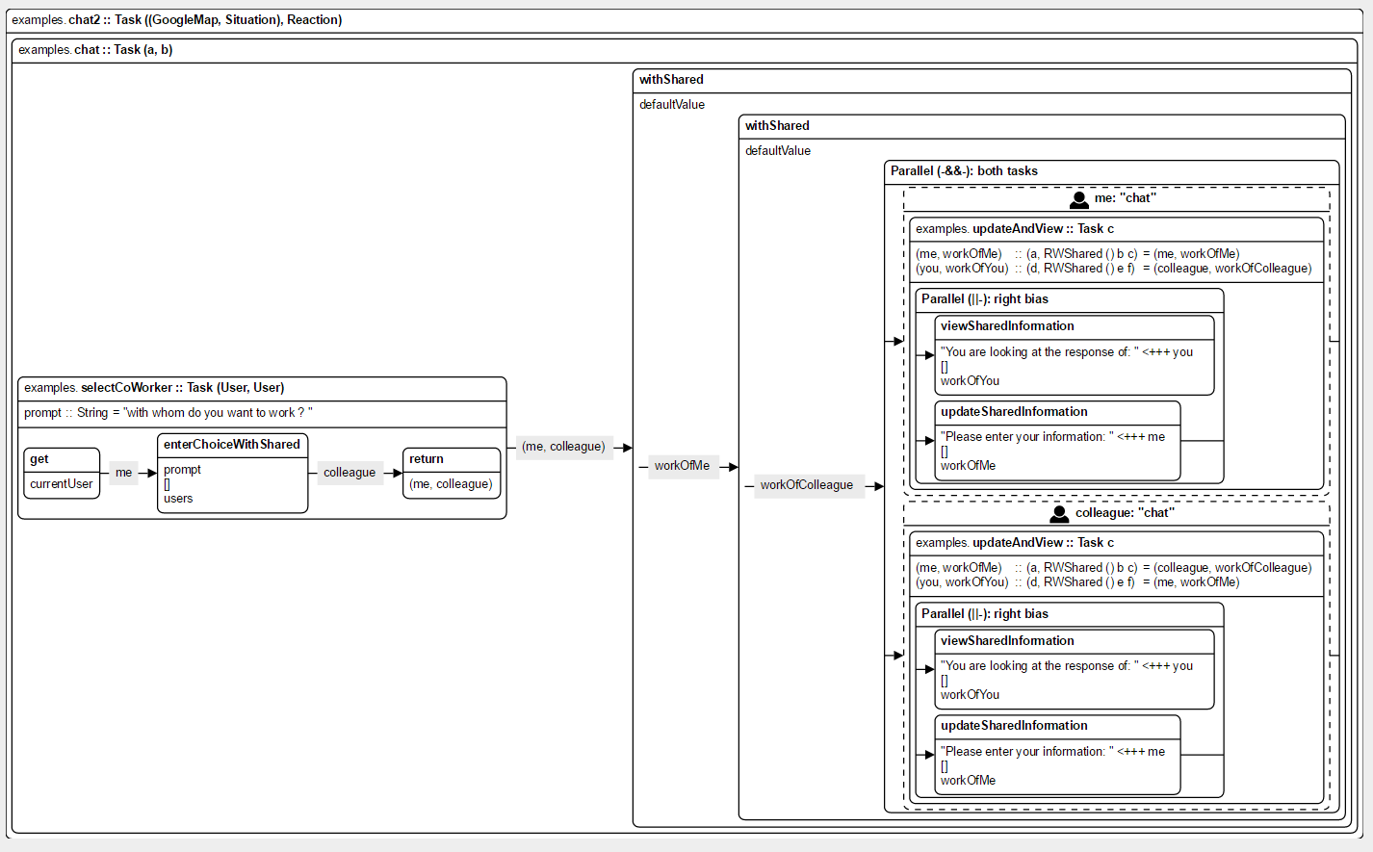
Editors on SDS’s
27
Notes:
27

Slide 28
Predefined Tasks for managing tasks
module example
import iTasks
Start :: *World → *World
Start world = startEngine palindrome world
palindrome :: Task (Maybe String)
palindrome = …
person1by1 :: Task [Person]
person1by1 = …

Slide 29
Predefined Tasks for managing tasks
module examples
import iTasks
Start :: *World → *World
Start world = doTasks myTasks world
myTasks
= installWorkflows myWorkFlows
>>| loginAndManageWork "welcome to my examples"
myWorkFlows :: [Workflow]
myWorkFlows
= [ workflow "palindrome" "accepts palindrome string " palindrome
, workflow "create list of persons“ "one by one" person1by1
, …
, workflow "Manage users" "Manage system users..." manageUsers
]
palindrome :: Task (Maybe String)
palindrome = …
person1by1 :: Task [Person]
person1by1 = …

Slide 30
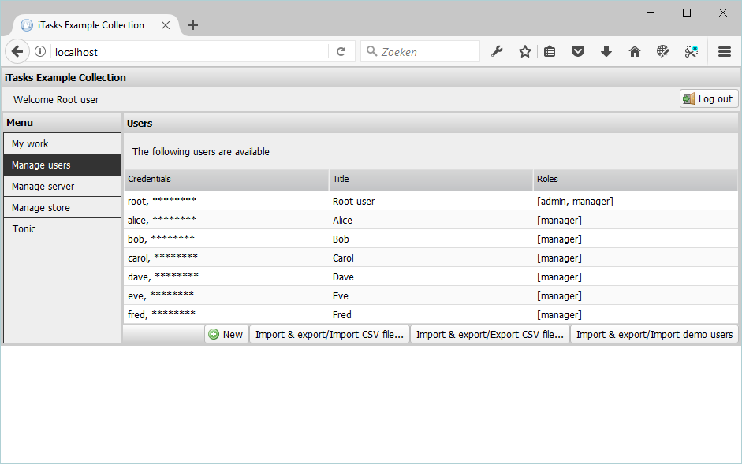
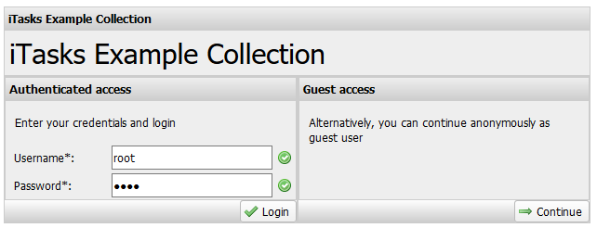
Predefined Tasks for managing tasks

